Slide 1


Week 9
Motor Wiring Method
MEC 415 Industrial Controls

Slide 2
Class Assignment Questions
What version of the Canadian Electrical Code (CEC) is the most current?
Which Rule Section is relevant to us for installing motors?
Which Rules did we look at during class today?

Slide 3
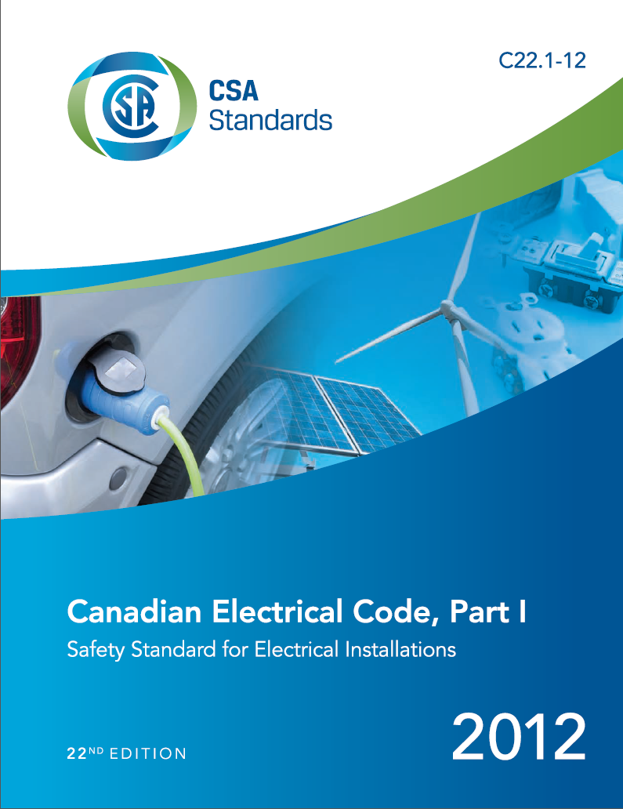

Slide 4
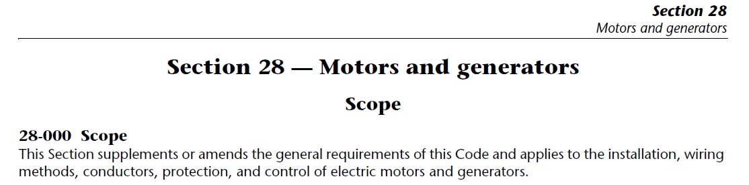
Canadian Electrical Code (CEC)
In Canada, every province and territory adopts and enforces the same installation code, the Canadian Electrical Code (CEC), Part I, Electrical Installations.
In particular, motor wiring is discussed in CEC, Rule Section 28.

Slide 5
Canadian Electrical Code (CEC)
In Alberta, Canadian Electrical Code, Part I (22th Edition), Safety Standard for Electrical Installations can be obtained from municipalaffairs.gov.ab.ca which would re-direct to an online Canadian Standards Association (CSA) web store.
In this portion of the course, we will look at how to determine copper conductor size, overcurrent and overload protection based on certain Rules from Rule Section 28.

Slide 6
CEC Rules
We are going to examine the following four Rules:
Rule 28-104 Motor Supply Conductor Insulation Temperature Rating and Ampacity
Rule 28-106 Conductors, Individual Motors
Rule 28-200 Branch Circuit Overcurrent Protection
Rule 28-306 Rating or Trip Selection of Overload Devices

Slide 7
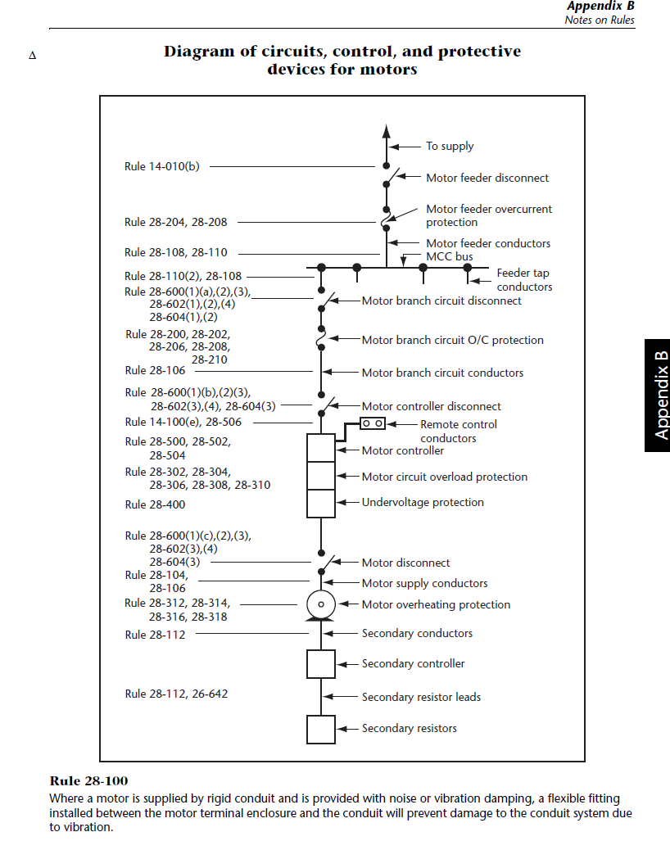
501

Slide 8
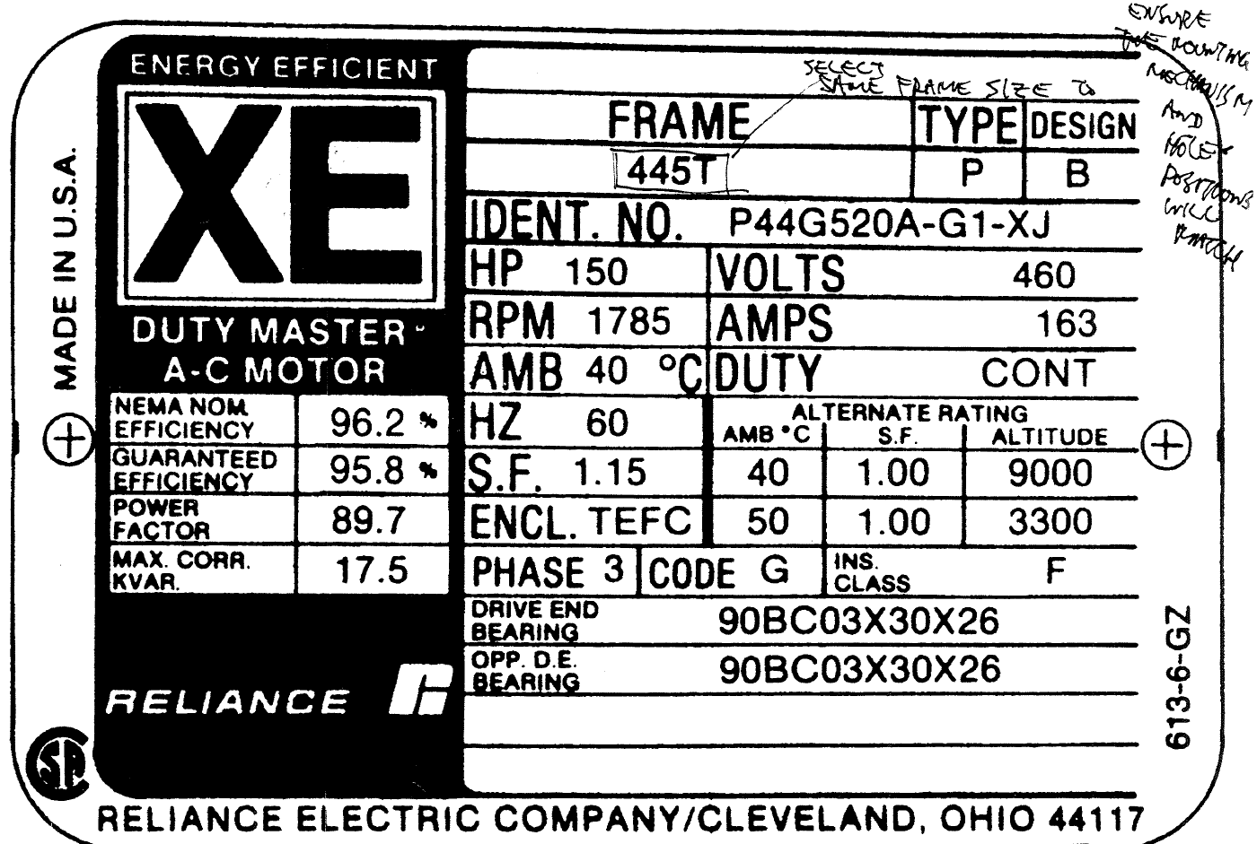

Slide 9
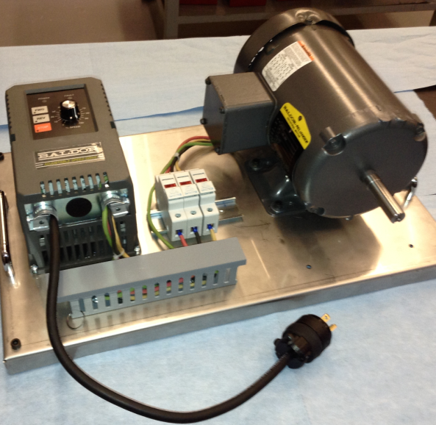
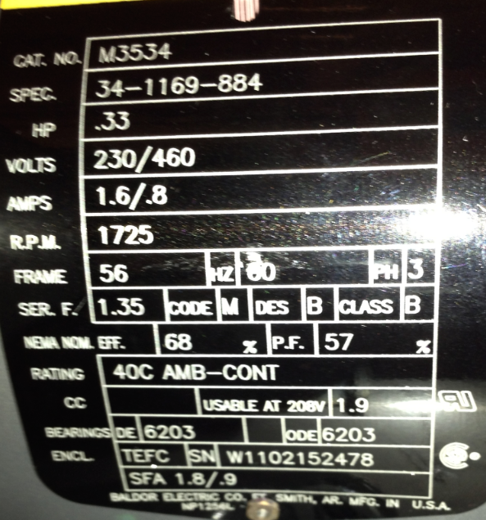
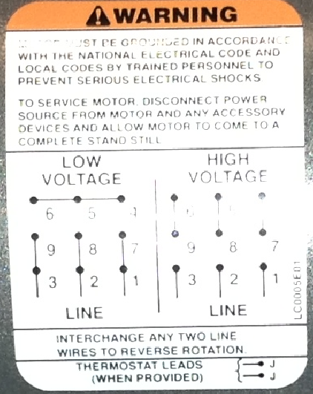

Slide 10
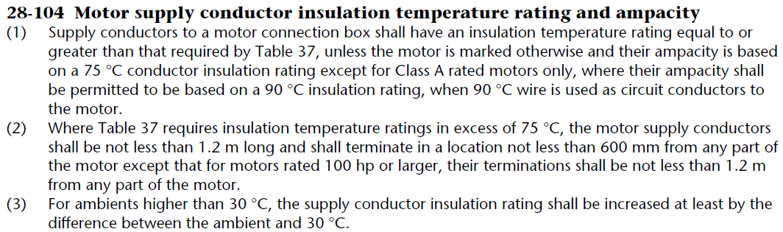
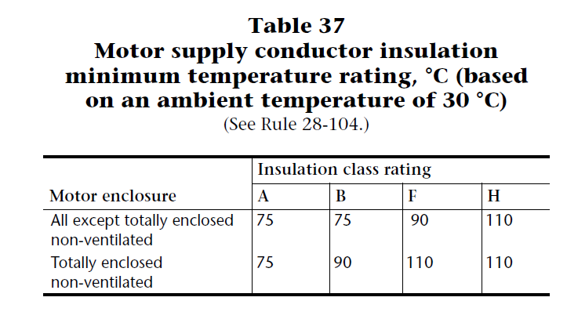
Rule 28-104 Motor Supply Conductor Insulation Temperature Rating and Ampacity (p. 204, 393)

Slide 11
501

Slide 12
Rule 28-106 Conductors, Individual Motors (p 204, 388)
Once conductor temperature rating is determined, the minimum wire size can then be selected per Rule 28-106

Slide 13
501

Slide 14
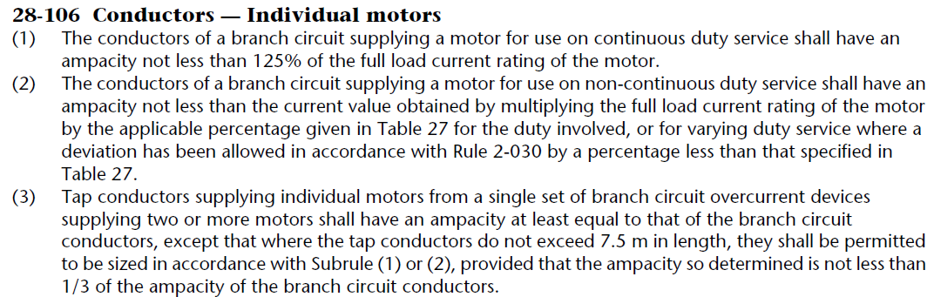
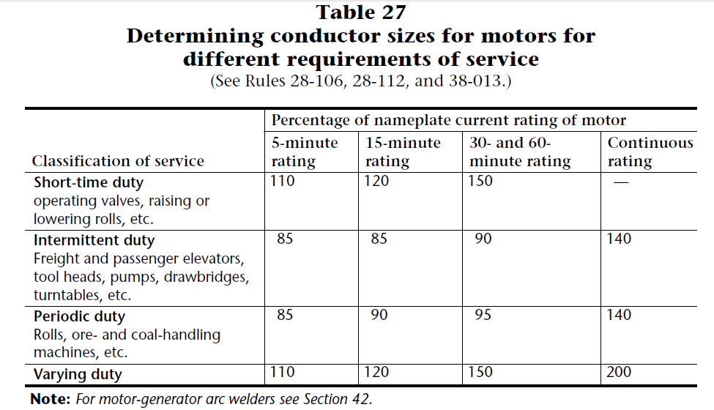
Rule 28-106 Conductors, Individual Motors (p 204, 388, 345, 346)

Slide 15
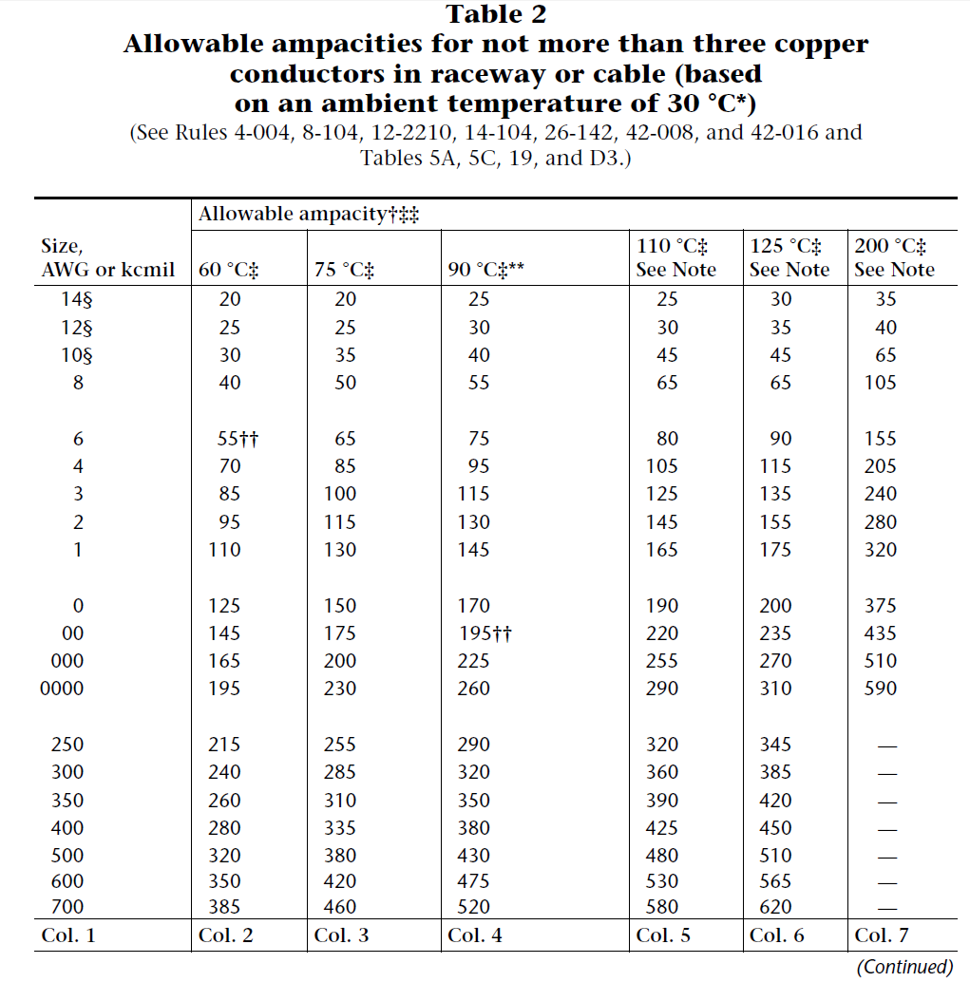

Slide 16
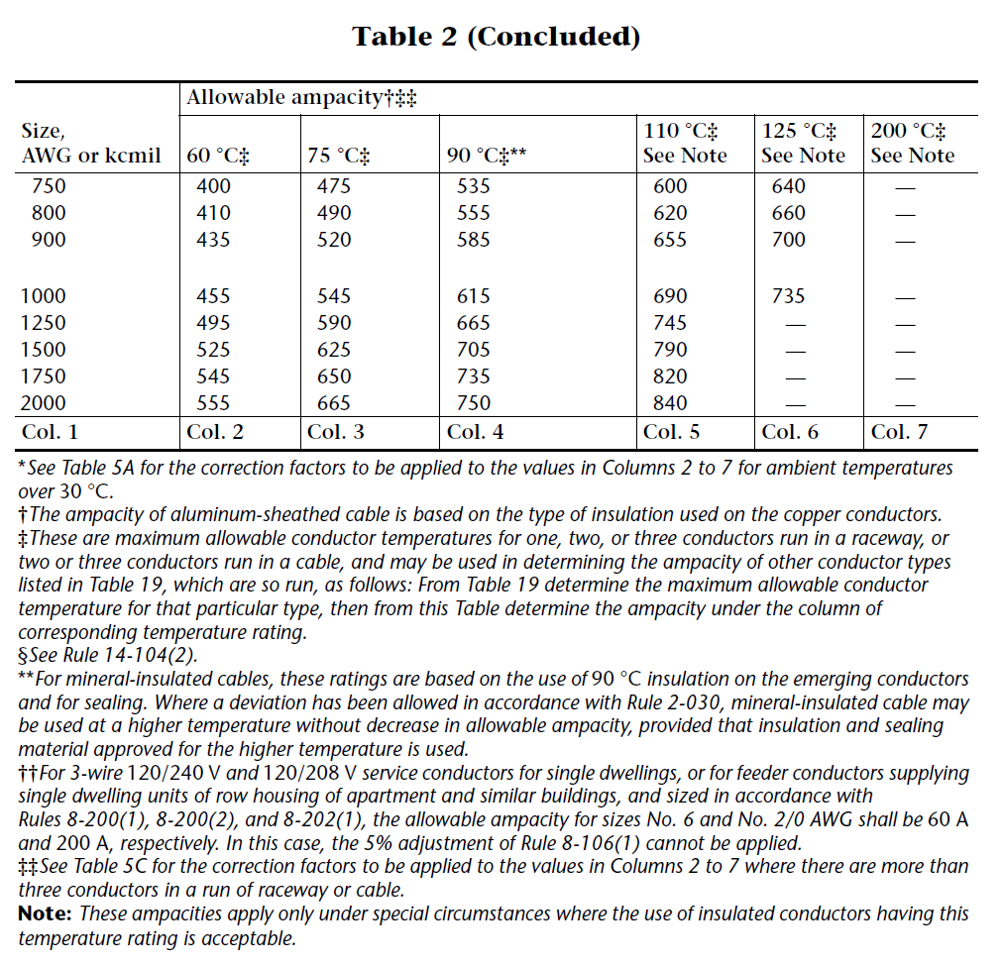

Slide 17
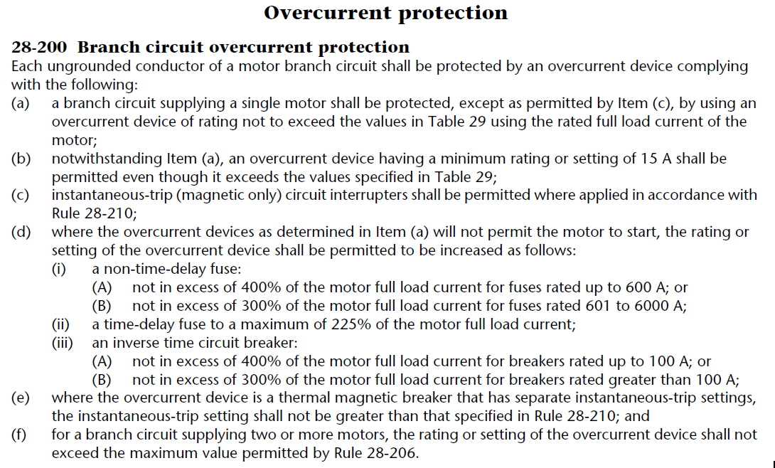
Rule 28-200 Branch Circuit Overcurrent Protection (p, 205, 389)

Slide 18
501

Slide 19
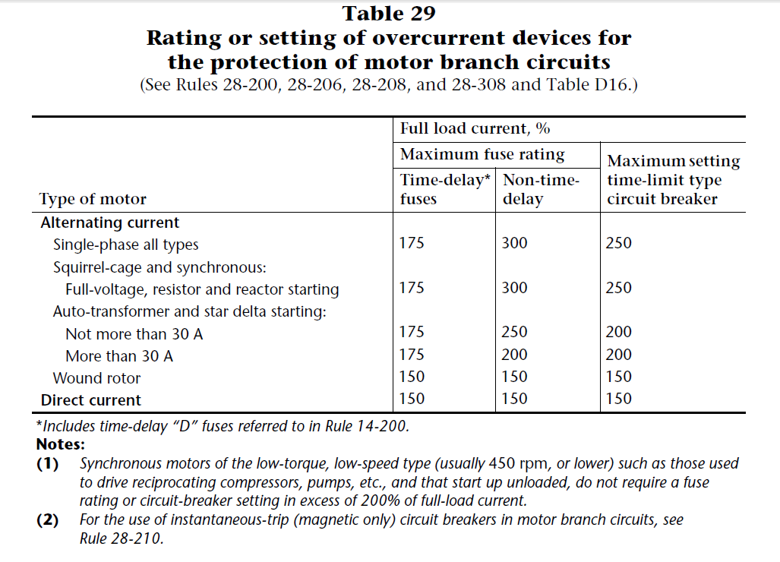
Rule 28-200 Branch Circuit Overcurrent Protection

Slide 20
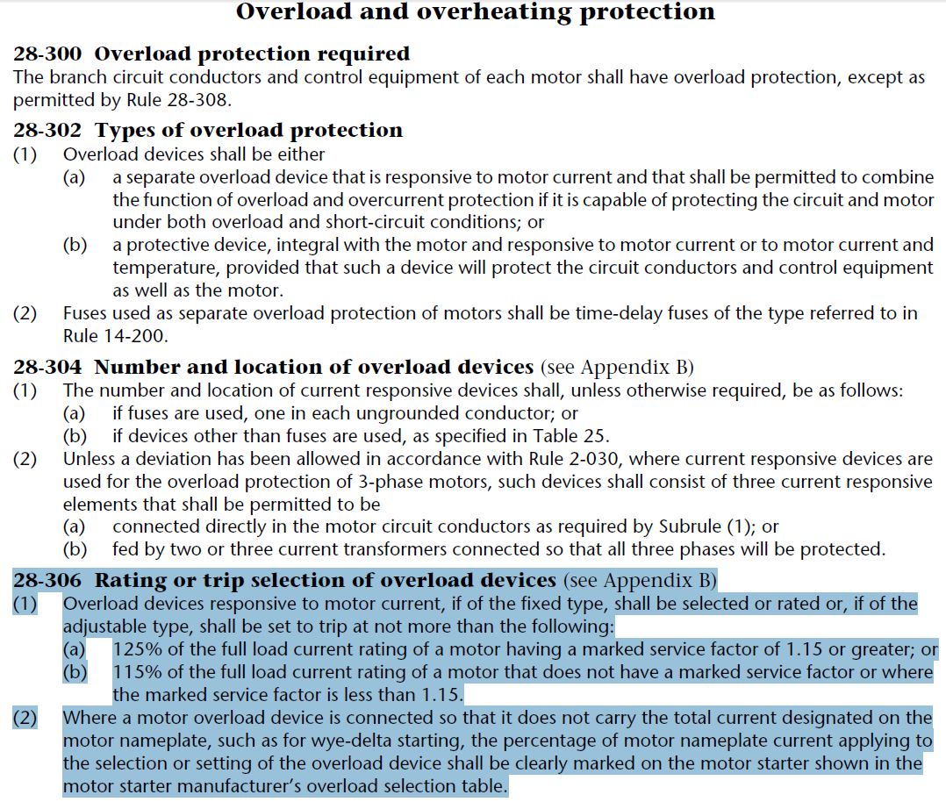
Rule 28-306 Rating or Trip Selection of Overload Devices

Slide 21
501

